Slide 1
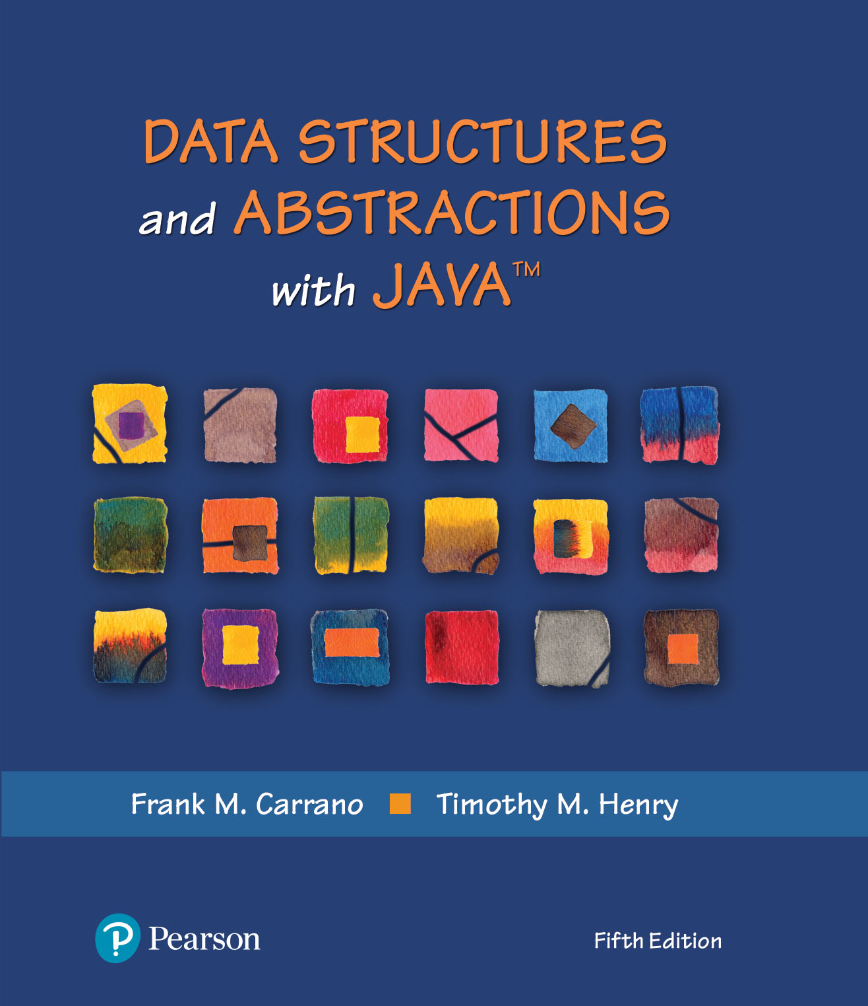
Binary Search Tree Implementation
Chapter 26

Slide 2
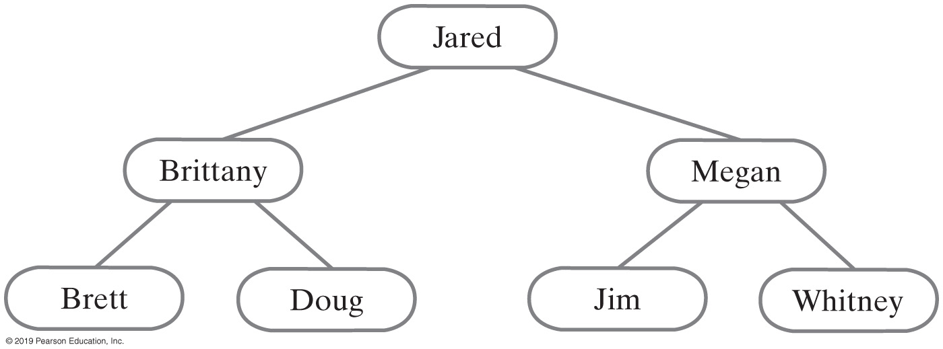
Binary Search Tree
For each node in a binary search tree
Node’s data is greater than all data in node’s left subtree
Node’s data is less than all data in node’s right subtree
Every node in a binary search tree is the root of a binary search tree

Slide 3
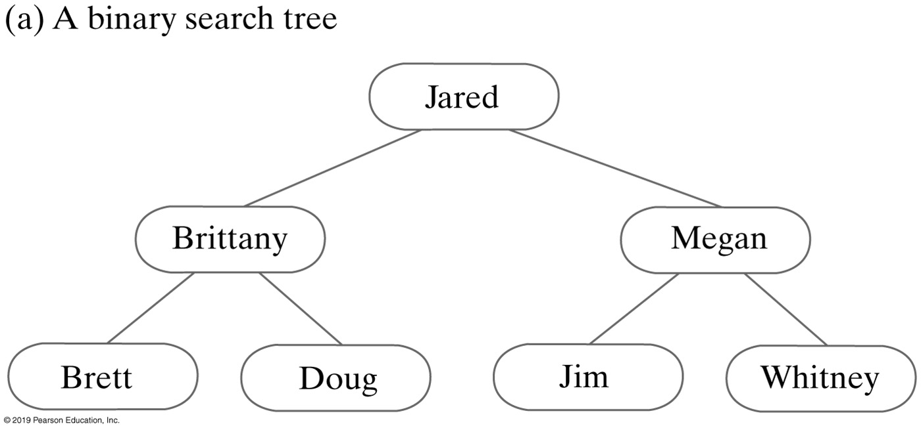
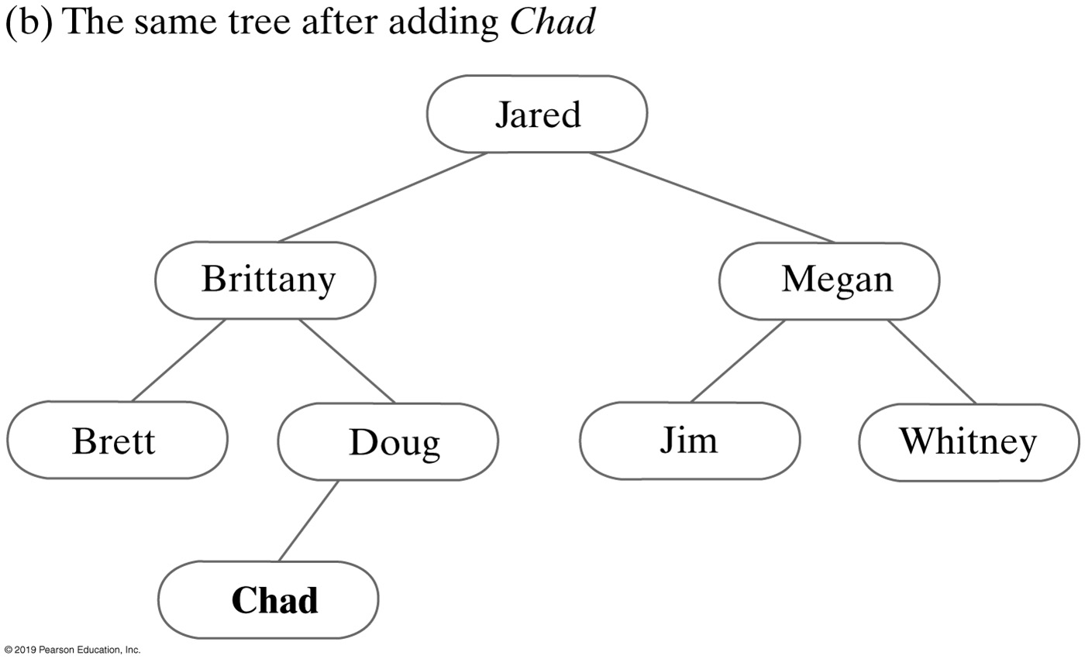
Adding to a Binary Search Tree
A binary search tree before and after adding Chad
Activity: Let’s add another name to the tree

Slide 4
Activity: Binary Search Tree
Create a BST [60, 50, 20, 80, 90, 70, 55, 10, 40, 35]
Notes:
What’s your observation?
Activity: draw AVL tree

Slide 5
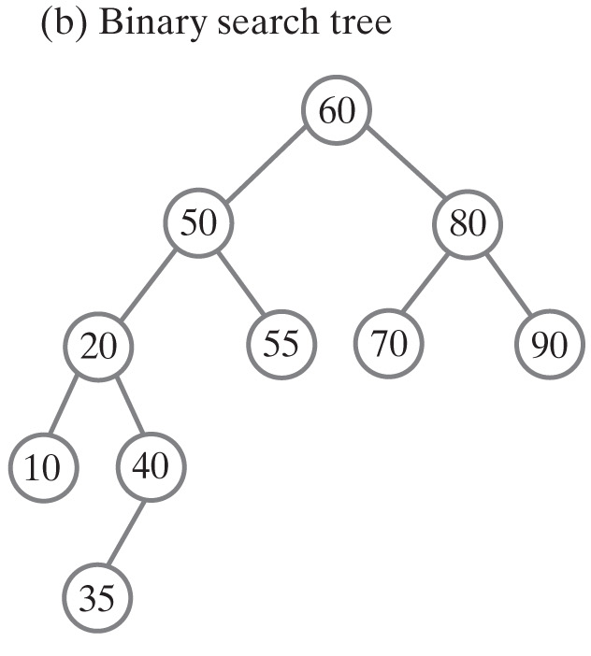
Solution: Binary Search Tree
Create a BST [60, 50, 20, 80, 90, 70, 55, 10, 40, 35]
Notes:
What’s your observation?
Activity: draw AVL tree

Slide 6
Interface for the Binary Search Tree (Part 1)
/** An interface for a search tree. */
public interface SearchTreeInterface<T extends Comparable<? super T>>
extends TreeInterface<T>
{
/** Searches for a specific entry in this tree.
@param anEntry An object to be found.
@return True if the object was found in the tree. */
public boolean contains(T anEntry);
/** Retrieves a specific entry in this tree.
@param anEntry An object to be found.
@return Either the object that was found in the tree or
null if no such object exists. */
public T getEntry(T anEntry);
/** Adds a new entry to this tree, if it does not match an existing
object in the tree. Otherwise, replaces the existing object with
the new entry.
@param anEntry An object to be added to the tree.
@return Either null if anEntry was not in the tree but has been added, or
the existing entry that matched the parameter anEntry
and has been replaced in the tree. */
public T add(T anEntry);

Slide 7
Interface for the Binary Search Tree (Part 2)
/** Removes a specific entry from this tree.
@param anEntry An object to be removed.
@return Either the object that was removed from the tree or
null if no such object exists. */
public T remove(T anEntry);
/** Creates an iterator that traverses all entries in this tree.
@return An iterator that provides sequential and ordered access
to the entries in the tree. */
public Iterator<T> getInorderIterator();
} // end SearchTreeInterface

Slide 8
Beginning the Class Definition
import java.util.Iterator;
/** A class that implements ADT binary search tree by extending BinaryTree. */
public class BinarySearchTree<T extends Comparable<? super T>>
extends BinaryTree<T> implements SearchTreeInterface<T>
{
public BinarySearchTree()
{
super();
} // end default constructor
public BinarySearchTree(T rootEntry)
{
super();
setRootNode(new BinaryNode<T>(rootEntry));
} // end constructor
// Disable setTree (see Segment 26.6)
public void setTree(T rootData, BinaryTreeInterface<T> leftTree,
BinaryTreeInterface<T> rightTree)
{
throw new UnsupportedOperationException();
} // end setTree
/* Implementations of other methods goes here. */
} // end BinarySearchTree
Notes:
SetTree() is an un supported operation

Slide 9
Searching and Retrieving
Algorithm bstSearch(binarySearchTree, desiredObject)
// Searches a binary search tree for a given object.
// Returns true if the object is found.
if (binarySearchTree is empty)
return false
else if (desiredObject == object in the root of binarySearchTree)
return true
else if (desiredObject < object in the root of binarySearchTree)
return bstSearch(left subtree of binarySearchTree, desiredObject)
else
return bstSearch(right subtree of binarySearchTree, desiredObject)
Recursive algorithm to search a binary search tree

Slide 10
Searching and Retrieving
private T findEntry(BinaryNode<T> rootNode, T anEntry)
{
T result = null;
if (rootNode != null)
{
T rootEntry = rootNode.getData();
if (anEntry.equals(rootEntry))
result = rootEntry;
else if (anEntry.compareTo(rootEntry) < 0)
result = findEntry(rootNode.getLeftChild(), anEntry);
else
result = findEntry(rootNode.getRightChild(), anEntry);
} // end if
return result;
} // end findEntry

Slide 11
Recursive Add Implementation
Algorithm addEntry(binarySearchTree, anEntry)
// Adds an entry to a binary search tree that is not empty.
// Returns null if anEntry did not exist already in the tree. Otherwise, returns the
// tree entry that matched and was replaced by anEntry.
result = null
if (anEntry matches the entry in the root of binarySearchTree)
{
result = entry in the root
Replace entry in the root with anEntry
}
else if (anEntry < entry in the root of binarySearchTree)
{
if (the root of binarySearchTree has a left child)
result = addEntry(left subtree of binarySearchTree, anEntry)
else
Give the root a left child containing anEntry
}
else // anEntry > entry in the root of binarySearchTree
{
if (the root of binarySearchTree has a right child)
result = addEntry(right subtree of binarySearchTree, anEntry)
else
Give the root a right child containing anEntry
}
return result

Slide 12
Recursive Implementation
public T add(T anEntry)
{
T result = null;
if (isEmpty())
setRootNode(new BinaryNode<>(anEntry));
else
result = addEntry(getRootNode(), anEntry);
return result;
} // end add
The public method add

Slide 13
Recursive Implementation — method addEntry
// Adds anEntry to the nonempty subtree rooted at rootNode.
private T addEntry(BinaryNode<T> rootNode, T anEntry)
{
// Assertion: rootNode != null
T result = null;
int comparison = anEntry.compareTo(rootNode.getData());
if (comparison == 0)
{
result = rootNode.getData();
rootNode.setData(anEntry);
}
else if (comparison < 0)
{
if (rootNode.hasLeftChild())
result = addEntry(rootNode.getLeftChild(), anEntry);
else
rootNode.setLeftChild(new BinaryNode<>(anEntry));
}
else
{
if (rootNode.hasRightChild())
result = addEntry(rootNode.getRightChild(), anEntry);
else
rootNode.setRightChild(new BinaryNode<>(anEntry));
} // end if
return result;
} // end addEntry

Slide 14
Iterative Implementation (1 of 2)
Algorithm addEntry(binarySearchTree, anEntry)
// Adds a new entry to a binary search tree that is not empty.
// Returns null if anEntry did not exist already in the tree. Otherwise, returns the
// tree entry that matched and was replaced by anEntry.
result = null
currentNode = root node of binarySearchTree found = false
while (found is false)
{
if (anEntry matches the entry in currentNode)
{
found = true
result = entry in currentNode
Replace entry in currentNode with anEntry
}
else if (newEntry < entry in currentNode)
{

Slide 15
Iterative Implementation (2 of 2)
if (currentNode has a left child)
currentNode = left child of currentNode
else
{
found = true
Give currentNode a left child containing anEntry
}
} // end if-else
else // anEntry > entry in currentNode
{
if (currentNode has a right child)
currentNode = right child of currentNode
else
{
found = true
Give currentNode a right child containing anEntry
}
} // end if
} // end while
return result

Slide 16
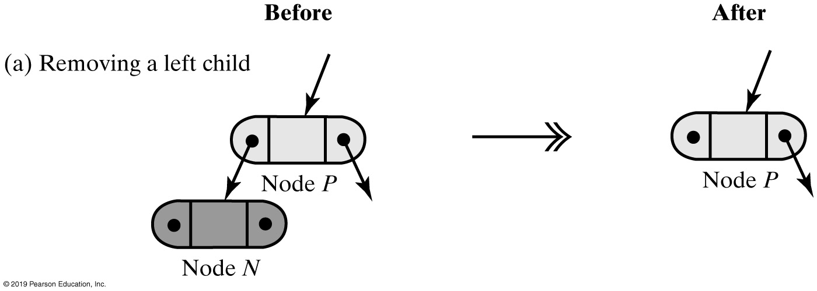
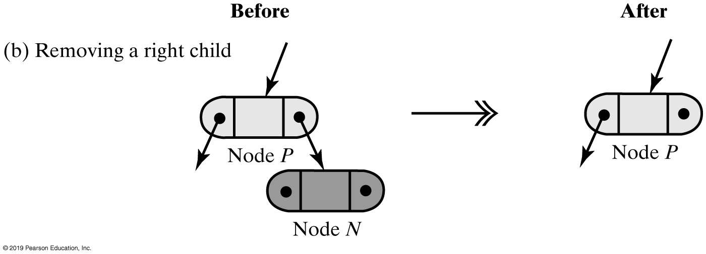
Removing a Value
Removing a leaf node N from its parent node P

Slide 17
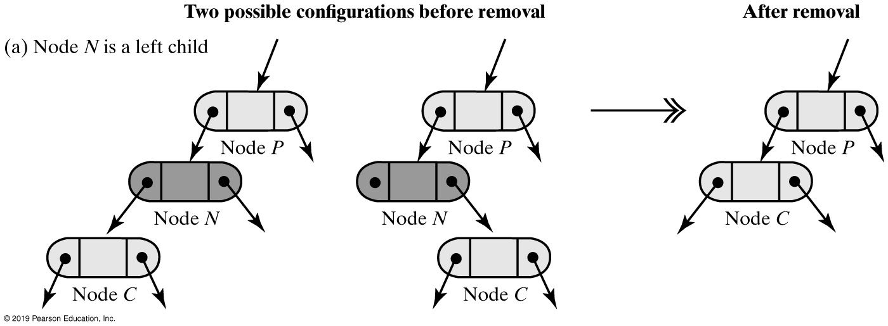
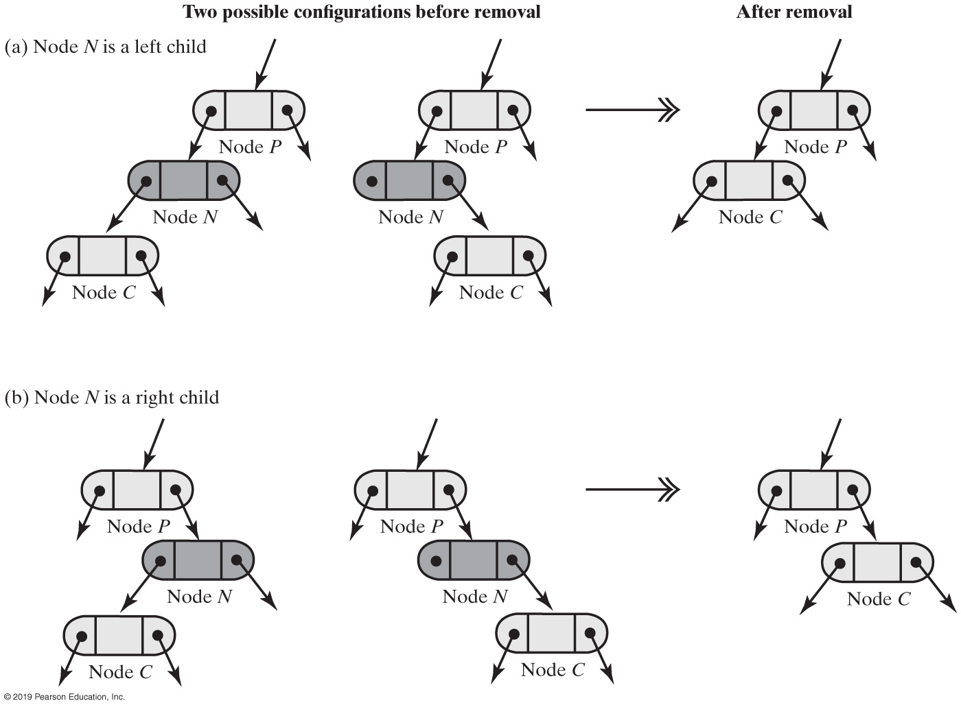
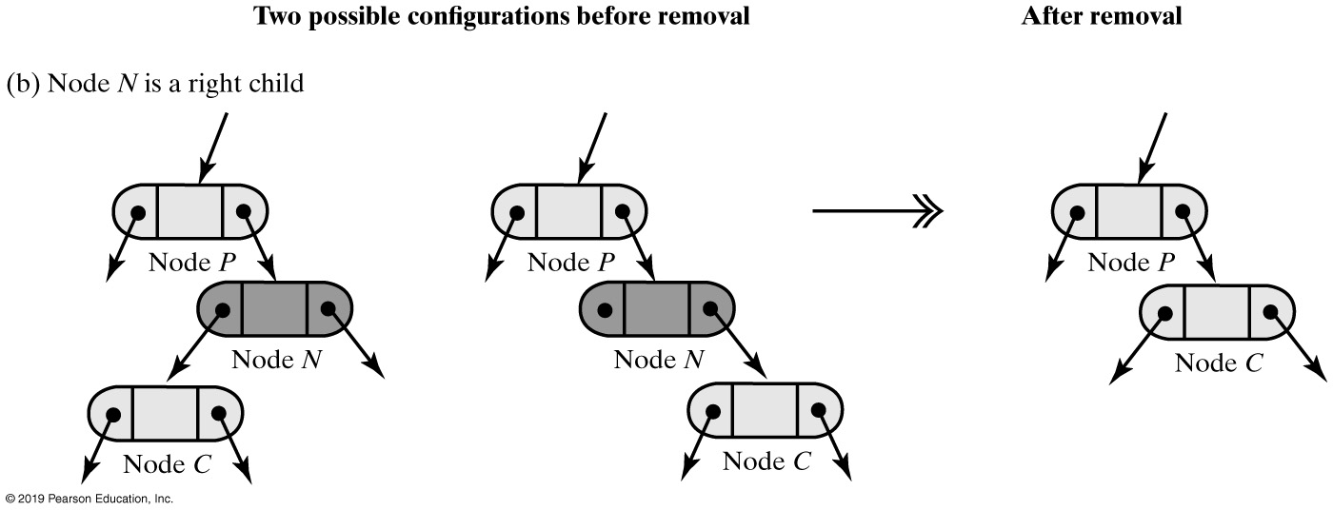
Removing a Value
Removing a node N from its parent node P when N has one child

Slide 18
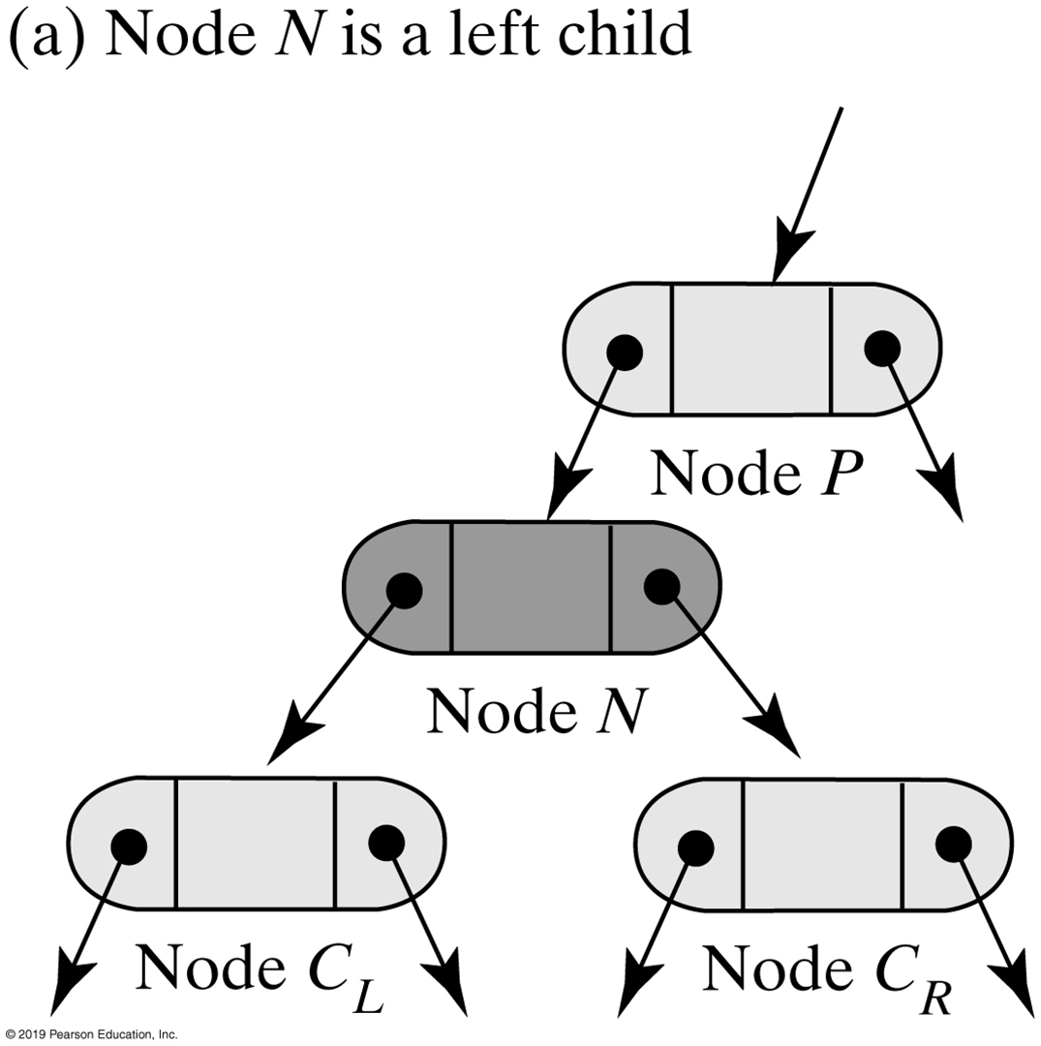
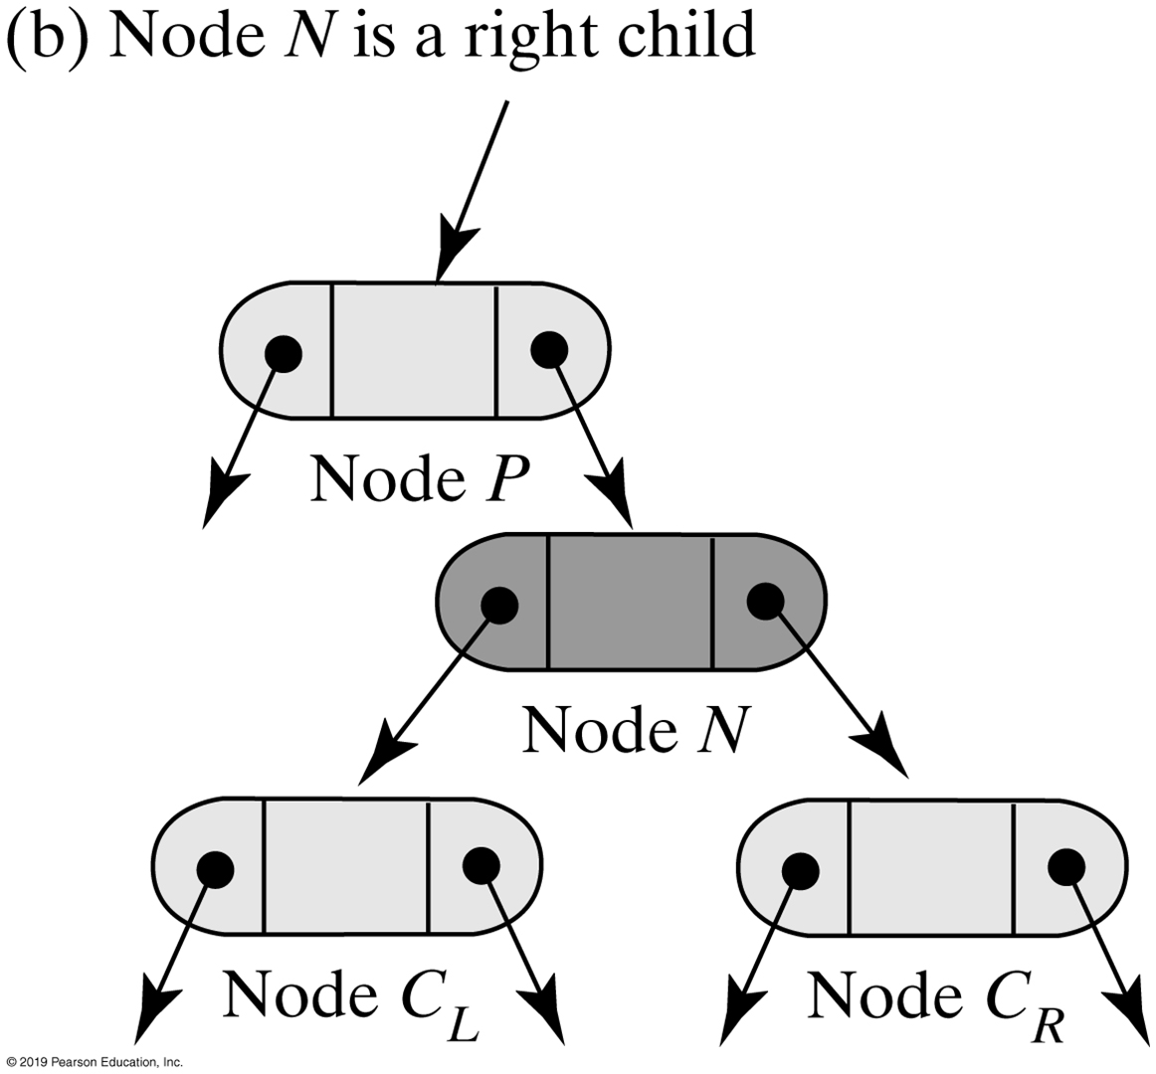
Removing a Value
Two possible configurations of a node N that has two children

Slide 19
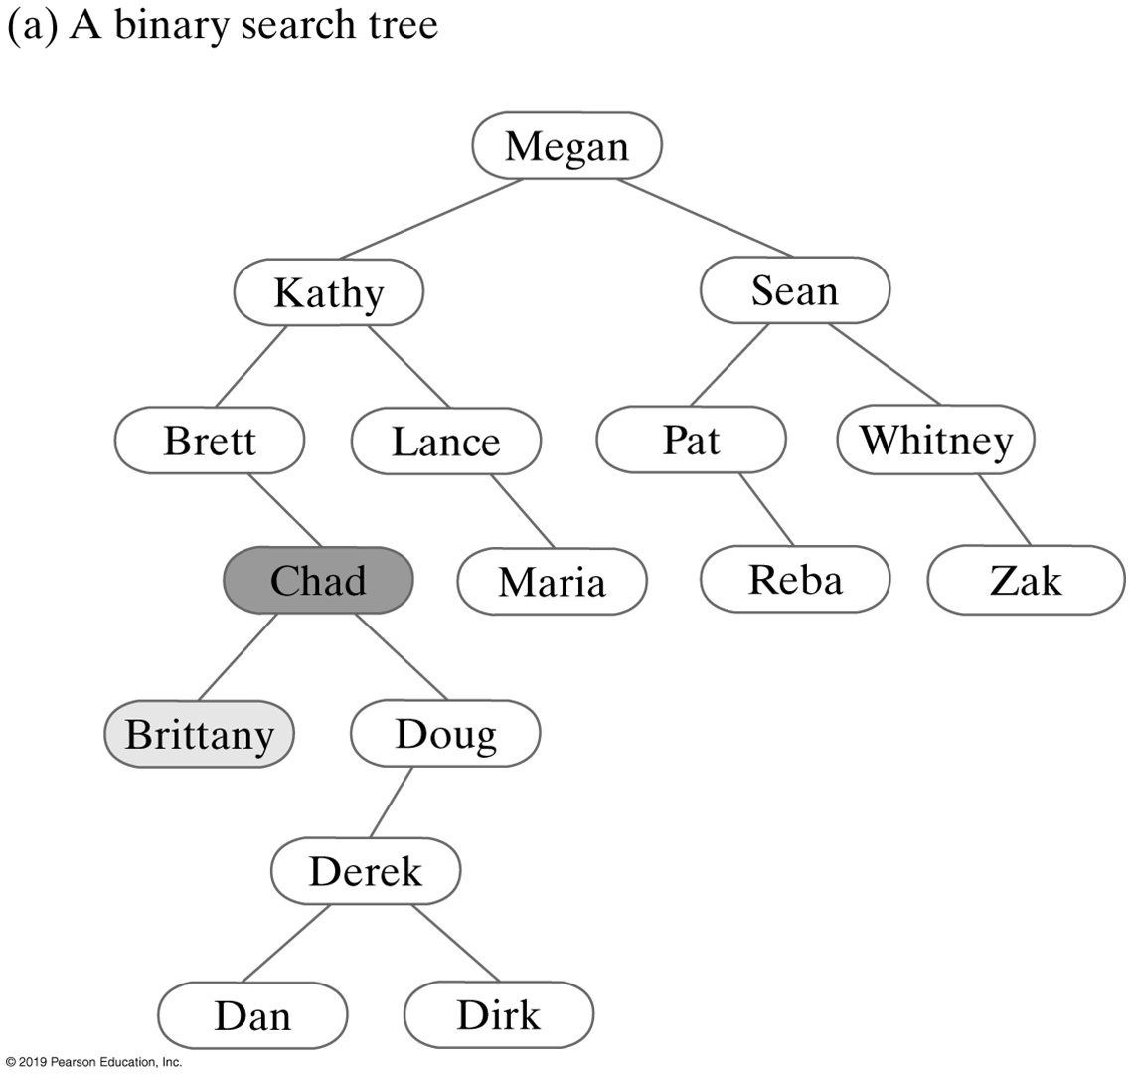
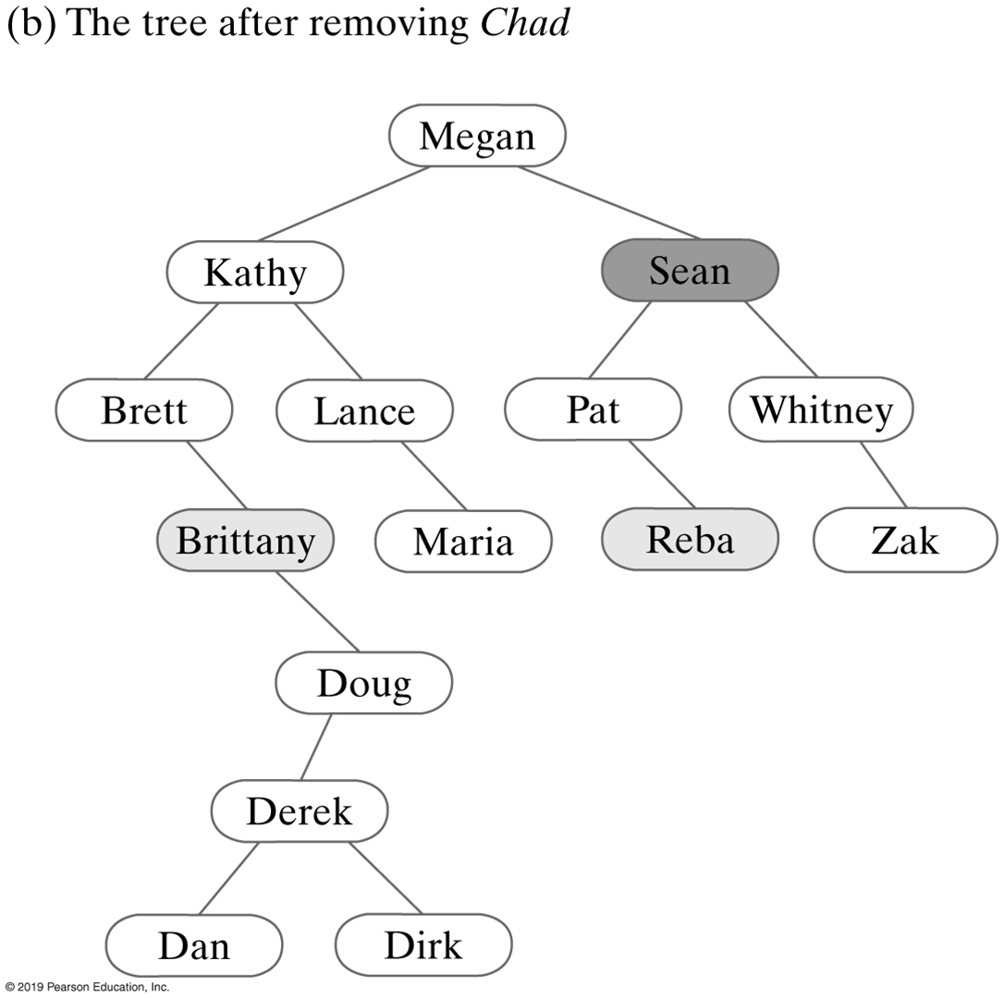
Successive removals from a binary search tree (Part 1)

Slide 20
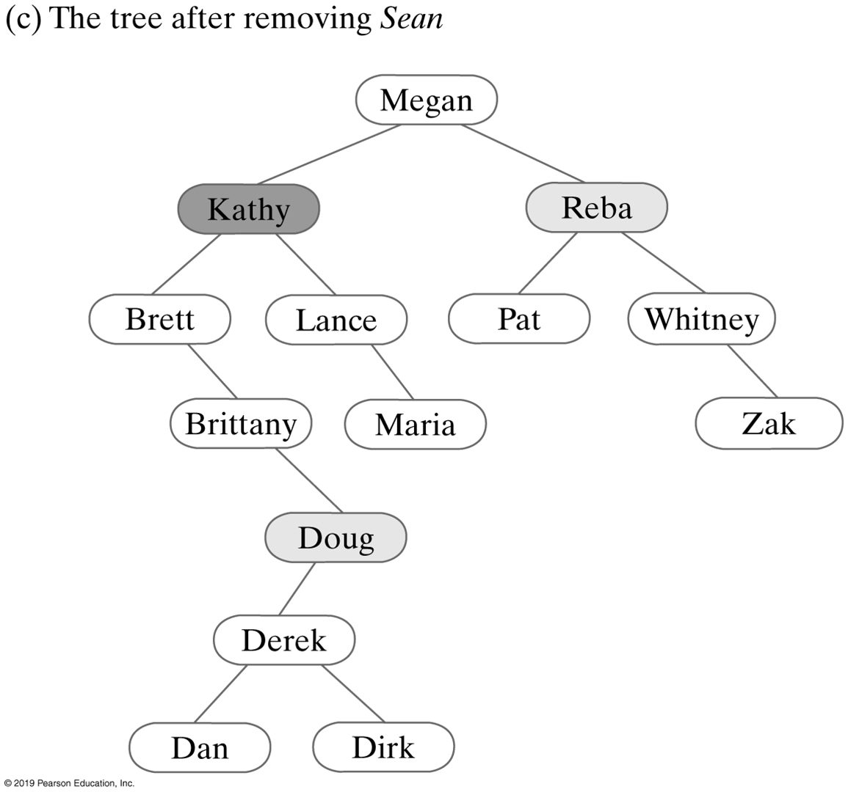
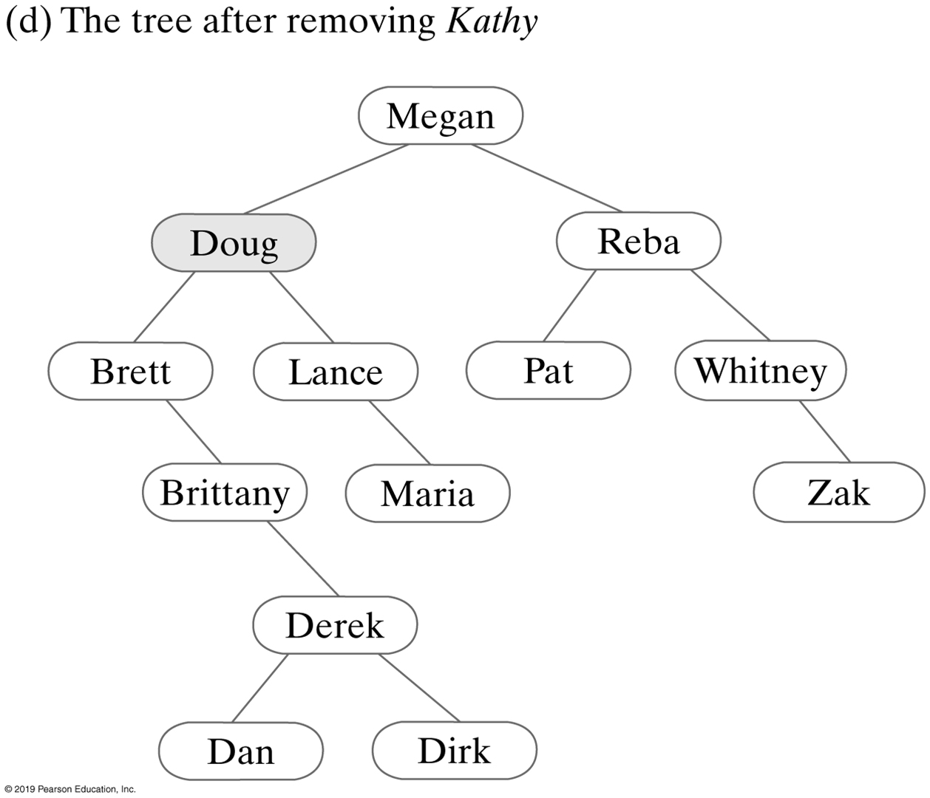
Successive removals from a binary search tree (Part 2)

Slide 21
BST | Remove

Slide 22
Recursive Implementation
Algorithm remove(binarySearchTree, anEntry)
oldEntry = null
if (binarySearchTree is not empty)
{
if (anEntry matches the entry in the root of binarySearchTree)
{
oldEntry = entry in root
removeFromRoot(root of binarySearchTree)
}
else if (anEntry < entry in root)
oldEntry = remove(left subtree of binarySearchTree, anEntry)
else // anEntry > entry in root
oldEntry = remove(right subtree of binarySearchTree, anEntry)
}
return oldEntry

Slide 23
Recursive Implementation
public T remove(T anEntry)
{
ReturnObject oldEntry = new ReturnObject(null);
BinaryNode<T> newRoot = removeEntry(getRootNode(), anEntry, oldEntry);
setRootNode(newRoot);
return oldEntry.get();
} // end remove

Slide 24
Recursive Implementation
// Removes an entry from the tree rooted at a given node.
private BinaryNode<T> removeEntry(BinaryNode<T> rootNode, T anEntry,
ReturnObject oldEntry)
{
if (rootNode != null)
{
T rootData = rootNode.getData();
int comparison = entry.compareTo(rootData);
if (comparison == 0) // anEntry == root entry
{
oldEntry.set(rootData);
rootNode = removeFromRoot(rootNode);
}
else if (comparison < 0) // anEntry < root entry
{
BinaryNode<T> leftChild = rootNode.getLeftChild();
BinaryNode<T> subtreeRoot = removeEntry(leftChild, anEntry, oldEntry);
rootNode.setLeftChild(subtreeRoot);
}
else // anEntry > root entry
{
BinaryNode<T> rightChild = rootNode.getRightChild();
// A different way of coding than for left child:
rootNode.setRightChild(removeEntry(rightChild, anEntry, oldEntry));
} // end if
} // end if
return rootNode;
} // end removeEntry

Slide 25
Recursive Implementation
Algorithm removeFromRoot(rootNode)
// Removes the entry in a given root node of a subtree.
if (rootNode has two children)
{
largestNode = node with the largest entry in the left subtree of rootNode
Replace the entry in rootNode with the entry in largestNode
Remove largestNode from the tree
}
else if (rootNode has a right child)
rootNode = rootNode’s right child
else
rootNode = rootNode’s left child // Possibly null
// Assertion: If rootNode was a leaf, it is now null
return rootNode

Slide 26
Recursive Implementation
// Finds the node containing the largest entry in a given tree.
// rootNode is the root node of the tree.
// Returns the node containing the largest entry in the tree.
private BinaryNode<T> findLargest(BinaryNode<T> rootNode)
{
if (rootNode.hasRightChild())
rootNode = findLargest(rootNode.getRightChild());
return rootNode;
} // end findLargest

Slide 27
Recursive Implementation
// Removes the entry in a given root node of a subtree.
private BinaryNode<T> removeFromRoot(BinaryNode<T> rootNode)
{
// Case 1: rootNode has two children
if (rootNode.hasLeftChild() && rootNode.hasRightChild())
{
// Find node with largest entry in left subtree
BinaryNode<T> leftSubtreeRoot = rootNode.getLeftChild();
BinaryNode<T> largestNode = findLargest(leftSubtreeRoot);
// Replace entry in root
rootNode.setData(largestNode.getData());
// Remove node with largest entry in left subtree
rootNode.setLeftChild(removeLargest(leftSubtreeRoot));
} // end if
// Case 2: rootNode has at most one child
else if (rootNode.hasRightChild())
rootNode = rootNode.getRightChild();
else
rootNode = rootNode.getLeftChild();
// Assertion: If rootNode was a leaf, it is now null
return rootNode;
} // end removeEntry

Slide 28
Recursive Implementation
// Removes the node containing the largest entry in a given tree.
// rootNode is the root node of the tree.
// Returns the root node of the revised tree.
private BinaryNode<T> removeLargest(BinaryNode<T> rootNode)
{
if (rootNode.hasRightChild())
{
BinaryNode<T> rightChild = rootNode.getRightChild();
rightChild = removeLargest(rightChild);
rootNode.setRightChild(rightChild);
}
else
rootNode = rootNode.getLeftChild();
return rootNode;
} // end removeLargest

